Slide 1
Siamese Networks to Enhance Model Performance
Capstone Meeting: October 23, 2024

Slide 2
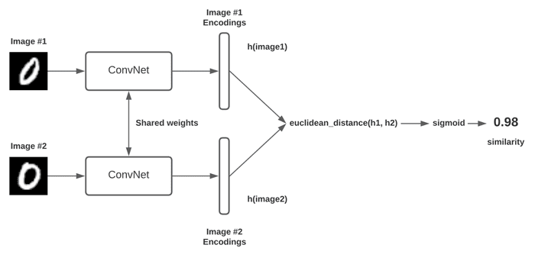
Siamese Networks: Overview
Siamese network: computer vision architecture where a single network contains two identical sub-networks, each which process a different image using the same weights
Outputs are then compared, generating a similarity score
Frequently used for same / different tasks
Notes:
https://pyimagesearch.com/2020/11/30/siamese-networks-with-keras-tensorflow-and-deep-learning/

Slide 3
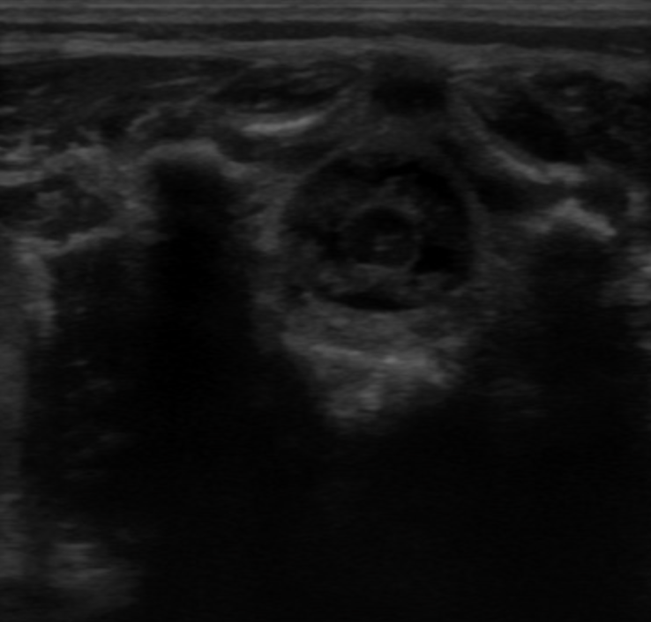
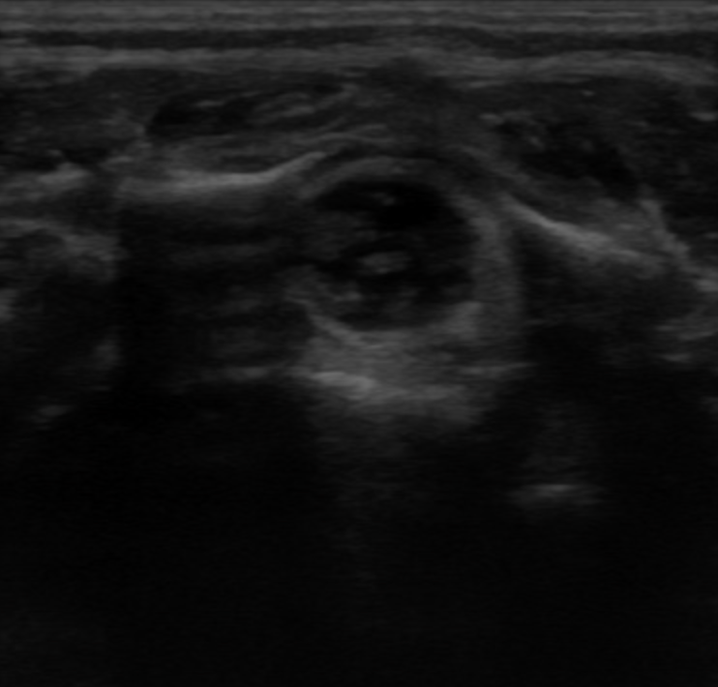
Siamese Networks: Usage
For this project, we think it makes most sense to focus on the supervised learning use cases of siamese networks, which function as follows:
Select a ground-truth image to compare images against (known object belonging to a specific class)
Generate similarity scores between sample images and ground-truth image
Optimize similarity score calculation using triplet or contrastive loss
Image to Test
Known image with cord / fluid
Notes:
https://pyimagesearch.com/2020/11/30/siamese-networks-with-keras-tensorflow-and-deep-learning/

Slide 4
Siamese Networks: Project Relevance
Option 1: Using siamese networks to classify known images
Can adapt existing CV architectures (ResNet18, VisionTransformer, etc.) into siamese networks and assess ability to classify images
Requires selecting one or more images as ground-truth labels (for example, selecting an image that is clearly poor-quality and using to detect poor-quality images)
Option 2: Using siamese networks to generate labels for unseen images
Can use siamese networks to generate labels for images that haven’t been seen, by comparing unseen images to images with known labels
Could speed-up time to generate labels for images
Would again require selecting images as ground-truth labels
Notes:
https://pyimagesearch.com/2020/11/30/siamese-networks-with-keras-tensorflow-and-deep-learning/

